Slide 1
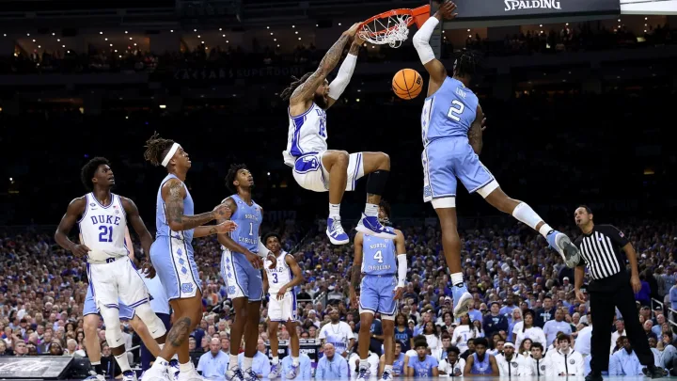


Final report on college basketball top 25 rankings in 2021
ALY 6010
Presentation Slides by Sean McLean

Slide 2
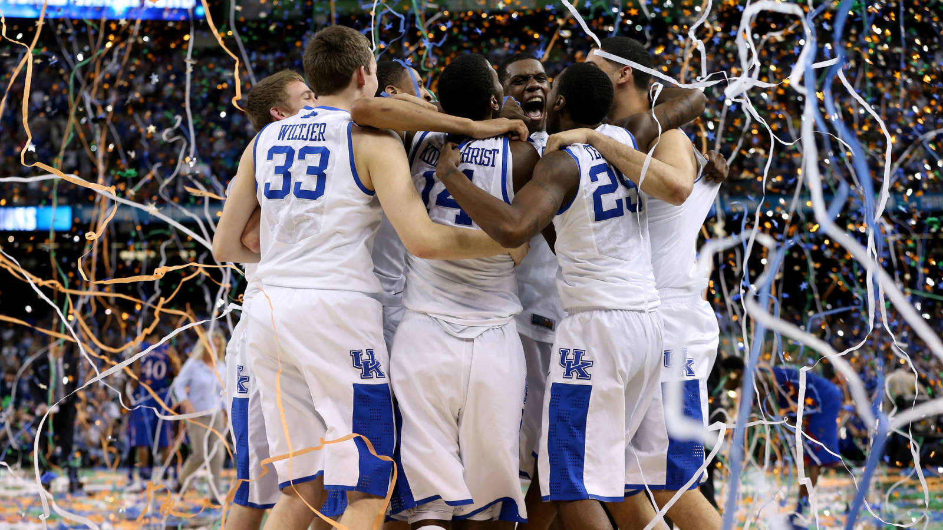
Overview Of The Dataset
Dataset of all the rankings from every ranking system for every Division I school in college basketball for the duration of the 2020-2021 season.
Main focus is to provide the rankings for every week of the season and how it changes as the season progresses and schools perform.

Slide 3

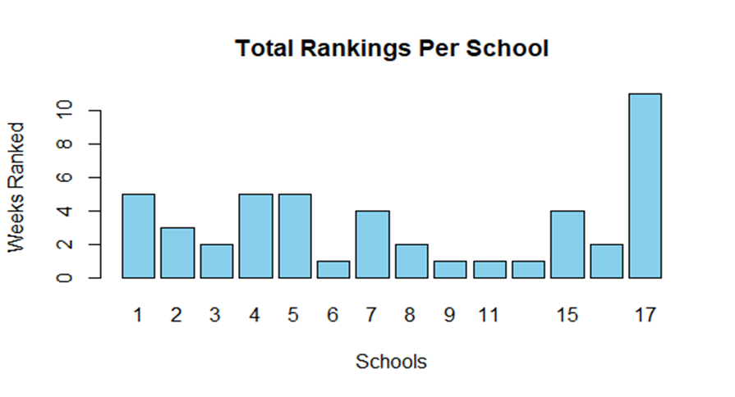
Minimal Number of Schools Ranked Condensing Dataset For Better Appearance Focus on Associated Press polls
Initial Dataset Takeaways

Slide 4


Questions generated
From the 15 teams that were ranked in both the first poll and final ranking, did the means of the team’s rankings between the two polls change from the first to final polls?
How much of a correlation is there between the rankings by the Associated Press and USA Today Coaches polls for the same week?
Do the schools that are ranked between the two ranking systems change consistently over the first and last polls of the season?

Slide 5
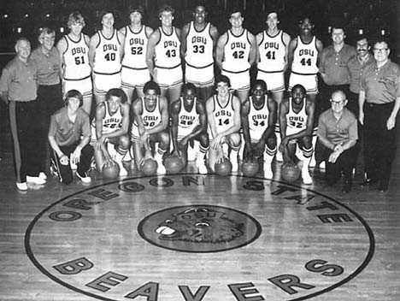
Some Testing hypotheses from questions
- There was a mean difference between the first poll and final poll using a two-sample test for the 15 schools ranked in both.
- There is no correlation between the rankings of the two ranking systems for the same week.
-The schools ranked between the two polls change consistently between the first and last polls of the season.

Slide 6
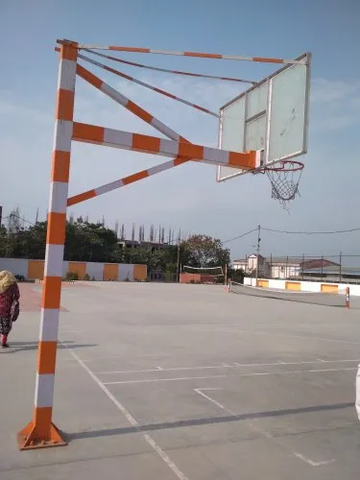
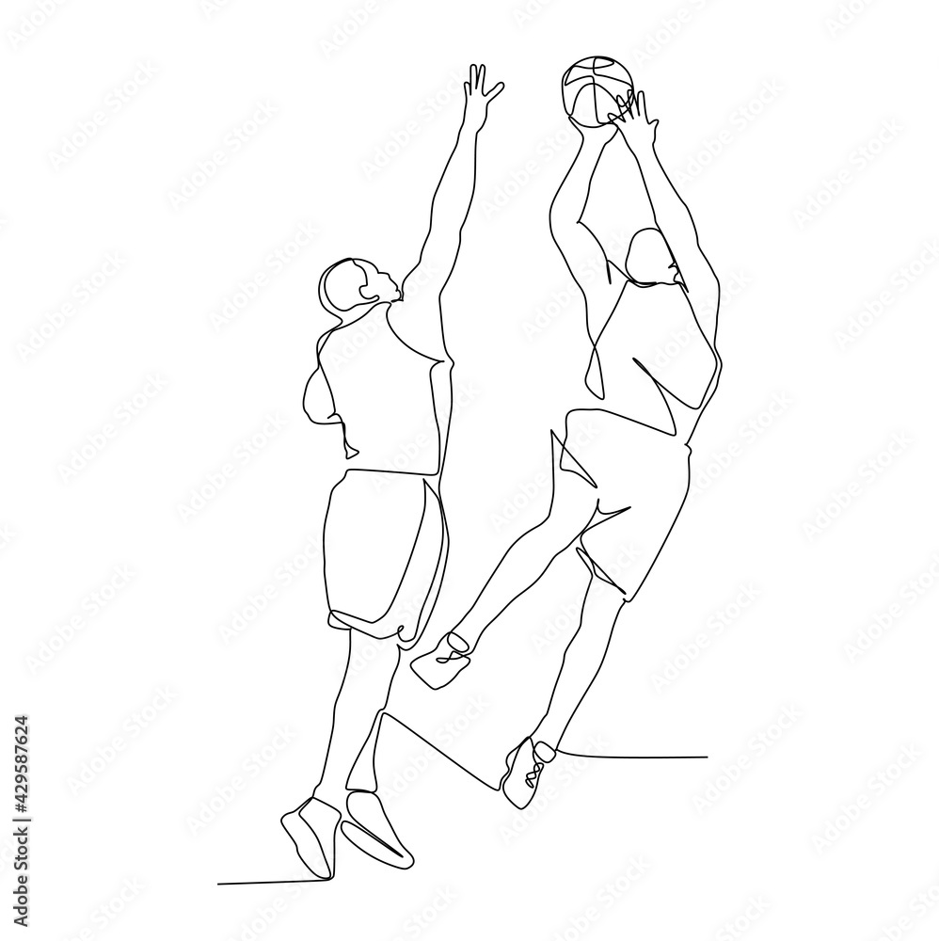
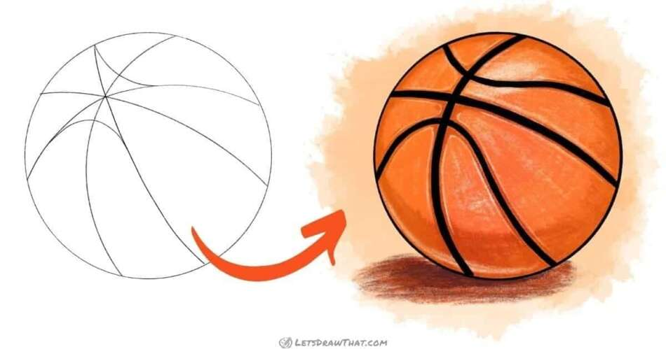
Key Findings And Insights: Question 1
Weak Correlations?
Minimal Poll Movement
Null Not Rejected

Slide 7
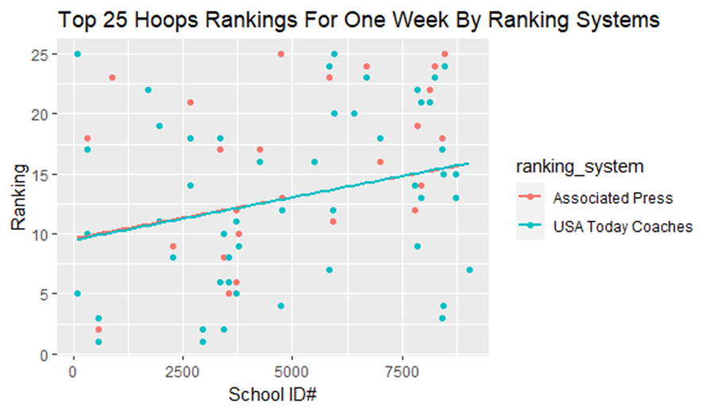
Key Findings & Insights: Question 2
Similar Rankings Between Polls.
More outliers from USA Today Coaches Poll.
Null Not Rejected.

Slide 8

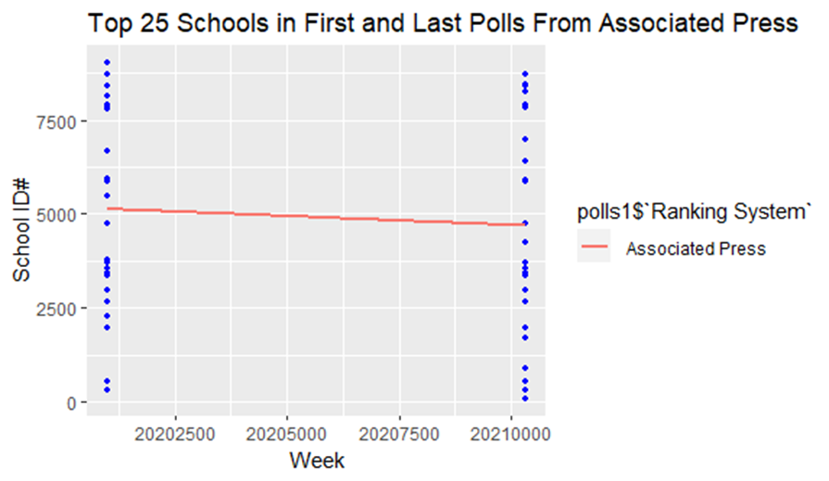
Key Findings & Insights: Question 3
Weak relationships among the selected variables.
Slightly negative regression line.
Less movement among schools in the weekly polls.

Slide 9
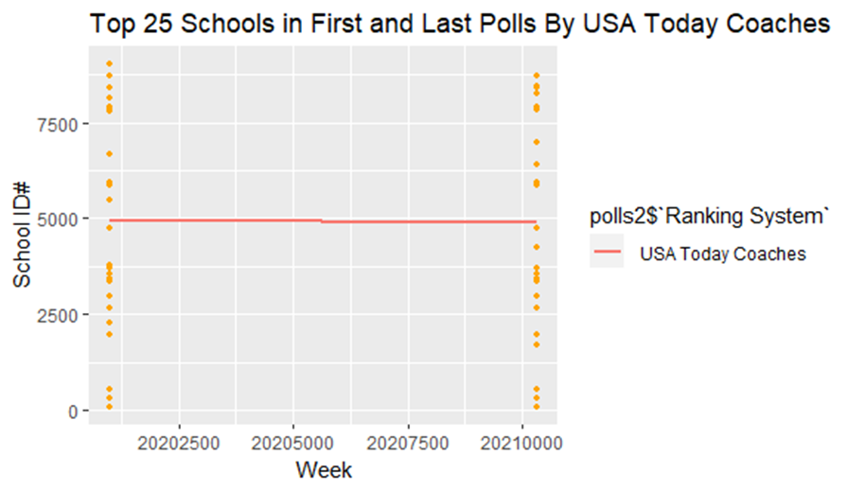
Key Findings & Insights: Question 3 (cont.)
Weak relationships among the selected variables.
Very slight negative regression line.
More movement in the polls compared to the other ranking system.

Slide 10
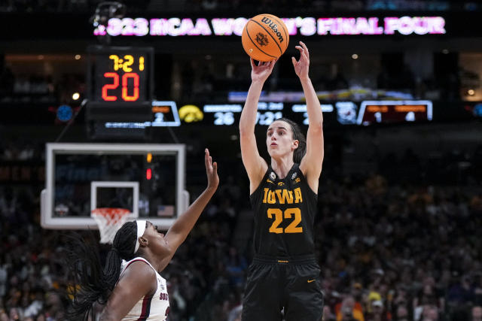
Interpretations of the Results
Strong relationships between schools and ranking systems.
Small percentage of schools ranked over the course of the season.
Reasons: Tradition? Strength of Schedule? Wins/Losses? Bias/Favoritism?

Slide 11
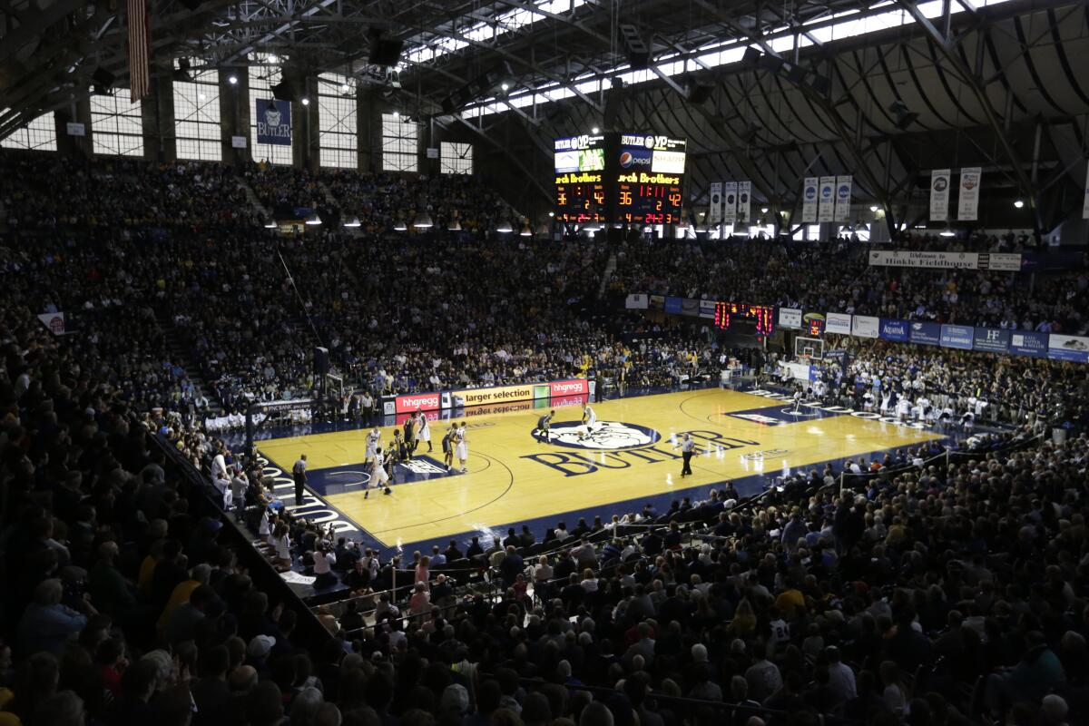
Conclusion
Thanks For A Great Class Everyone And Have A Great Winter Break!

